Slide 1
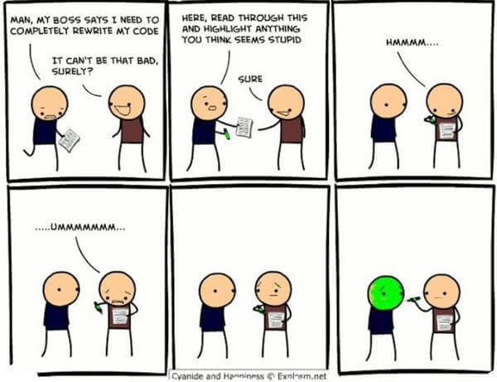
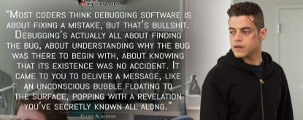
Efficiency and debugging
The art of failing less badly

Slide 2
Topics
Introduction: GUI and basic calculations
Coding 1: Scripts, style, and variable classes
Coding 2: Control statements and loops
Visualization 1: Basics, subplots, get and set
Coding 3: Functions
Visualization 2: Descriptive plots
Coding 4: Basic input and output
Visualization 3: Distribution and 3D plots
Coding 5: Input and output specials – last lecture before holidays
Machine Learning 1: Introduction and dimension reduction
Machine Learning 2: Clustering
Machine Learning 3: Classification
Coding 6: Efficiency and debugging basics
Coding 7: Advanced functions and debugging

Slide 3
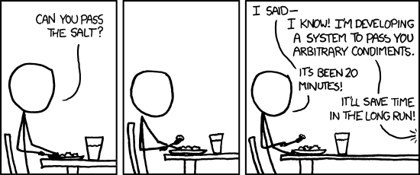
Efficiency
Pre-allocate matrices
zeros, ones, NaN, cell, struct, depending on the situation
Matrix operators are significantly faster than loops!
Use tic/toc and the profiler
https://xkcd.com/974/

Slide 4
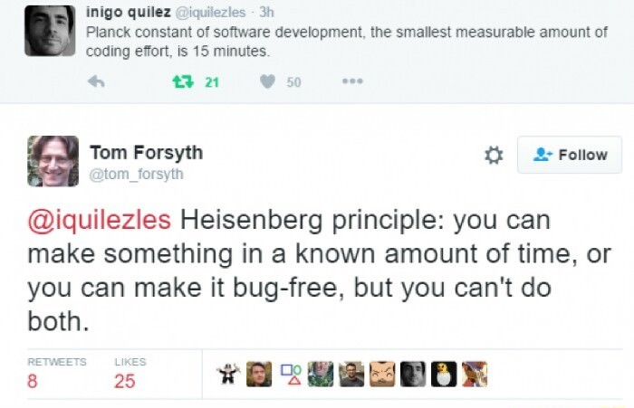
Debugging
If you know how to debug you know how to code.
Understanding errors, finding and fixing problems is the main part of programming
Every code is flawed.
Think first, understand your ideas.
Take breaks. Seriously.
More often than not the bug is in front of the screen, not inside.

Slide 5



Bugs
https://www.computing.co.uk/news/4034875/
microsoft-issues-security-advisory-windows-serioussam-zero-day-bug
Bug types:
You gave the wrong input from the start (well… happens way too often)
Some coding bugs directly crash your code with an error (good bugs)
Others seem to work but distort your results or might lead to errors way later (bad bugs)
Heisenbugs: behave differently when you inspect them very closely (pure agony)
Phase-of-the-moon-bugs: Bugs that are dependent on external factors
Anonymous bugs:
Uninitialized variables (might contain invalid data, often responsible for heisenbugs)
Variables have been overwritten
Many bugs start from working code that gets changed in a lazy way
They look nice at first but become increasingly difficult to manage, like a baby dragon
I want a baby dragon.
https://drawinghowtos.com/baby-dragon-2-7909/

Slide 6
Try-Catch Statements
Try, catch, end
Executes code after „try“, if an error happens, don‘t immediately crash but execute the code after „catch“
Use catch ME (MATLAB exception) and inspect ME
Error free does not mean bug free!
Beware of try catch in the wrong circumstances

Slide 7
Workspaces
All variables and their data are stored in the MATLAB workspaces
Scripts and the Command Window use the „base“ workspace
Functions have their own workspace, they can‘t access the base workspace!
You also can‘t access anything inside a function from the base workspace
The only way to get information in and out of a function are inputs and outputs
(there exist other ways but these are dirty hacks and shouldn‘t be used, change my mind.)
You can step into functions and inspect their workspace using the debugger.

Slide 8
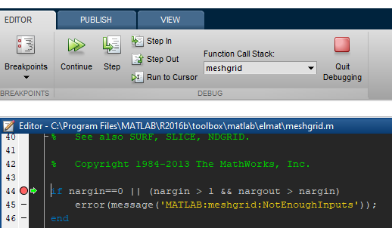
The Debugger
Your best friend.
Set breakpoints by clicking on the „–“ at the start of a line
Step Over, Step In, Step Out of a line
Mouse over a variable will tell you its size and value
Quit Debugging, type dbquit, or change and save the function
You can select the workspace to inspect in the debuger (Function Call Stack)
Useful: Editor -> Breakpoints -> Stop on error

Slide 9
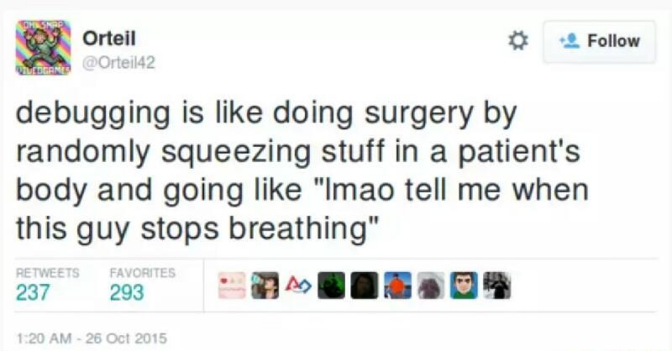
Strategy
Read the error message. (!)
Search the internet for the error message or the function if you don‘t understand it
Find the bug
Make the error message reproducible
Trace the bug to the first line of code that breaks
Follow the bug by executing single lines, inspect the data
Size() is often very helpful!
Plotting can be helpful, too

Slide 10
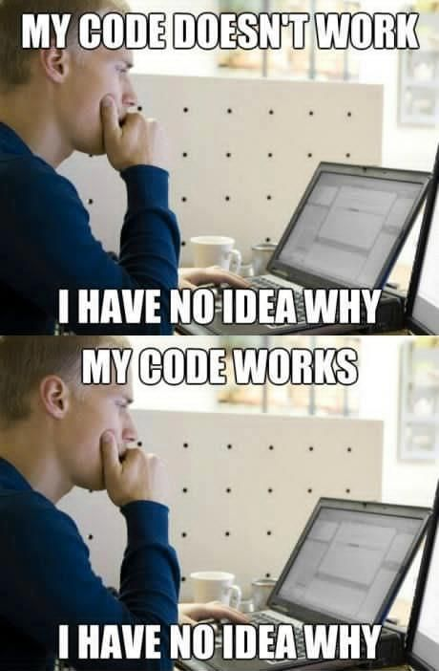
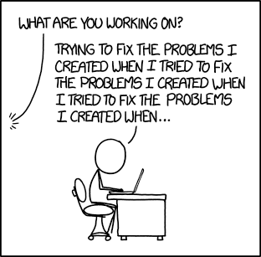
Strategy
Last but not least: Learn your lesson.
Understand where the bug came from. Think about Mr. Robot ;)
Fix it. This might mean a restructure of your code!

